Slide 1



Multigrid Methods for Structure Preserving Discretizations
CM2025
04/15/2025
Kevin Carlson
James Fairbanks, Luke Morris, George Rauta

Slide 2
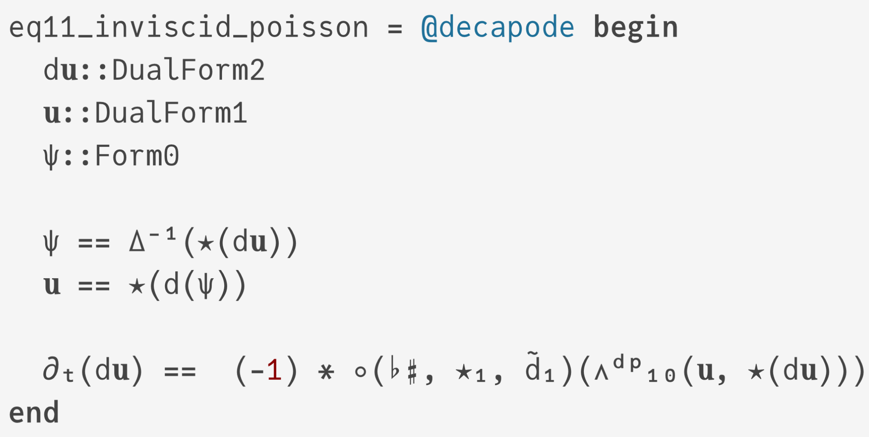
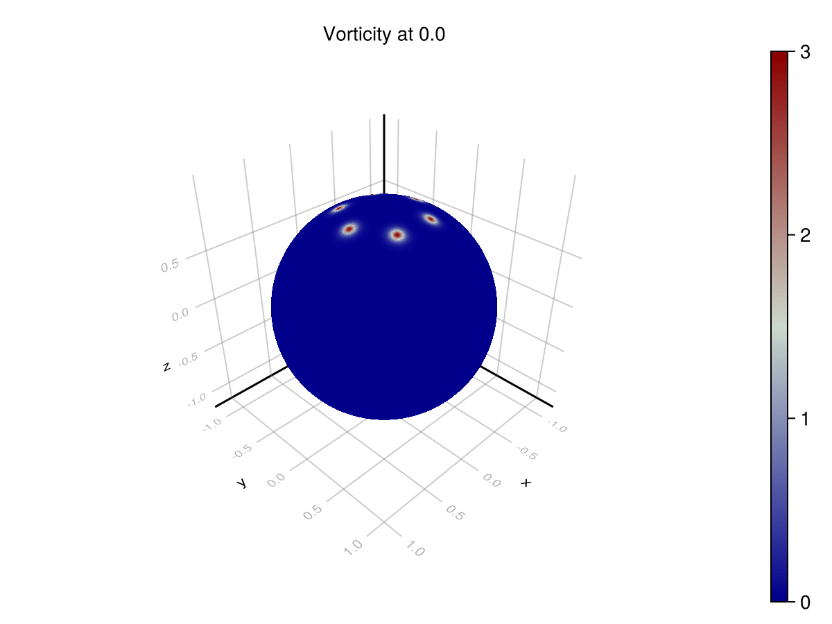
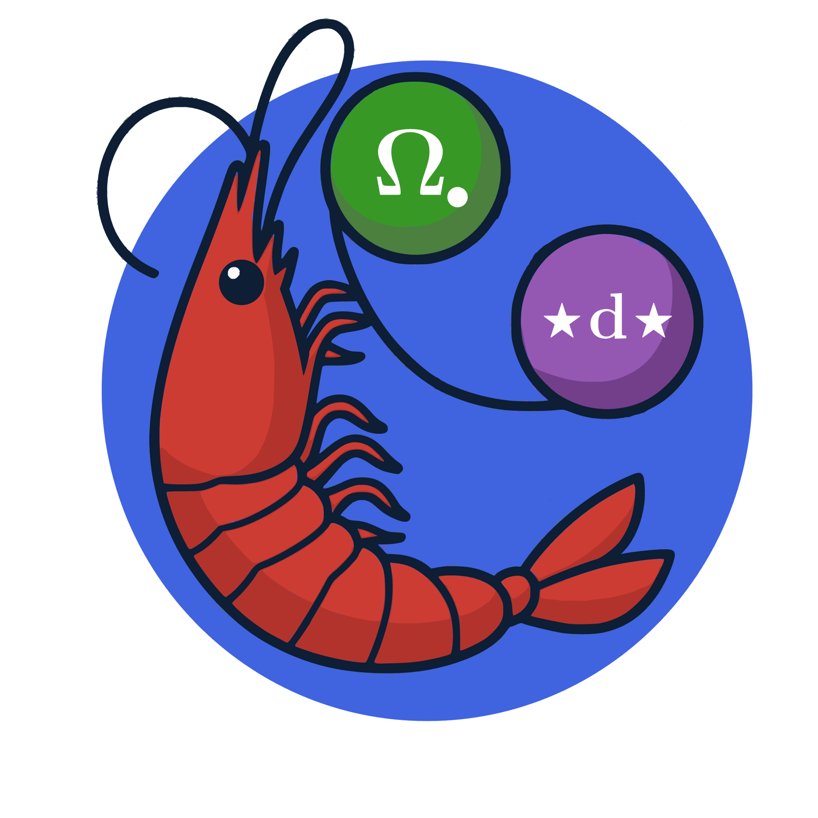
DECAPODES: A Framework for Directly Computable Physics
Decapodes.jl Simulation
Notes:
The DECAPODES software platform uses Exterior Calculus, a novel approach to the mathematics of shape and quantity to support simulation software that is easier to user, faster, and more accurate than existing approaches. This software solves problems in physics, chemistry, biology, and engineering.
Funded by: DARPA Defense Science Office PM Jan Vandenbrande / LTC David Lewis, Information Innovation Office Joshua Elliot / Erica Briscoe, DSO Young Faculty Award
Potential Funders: Navy Research Lab – Stennis, MS, Army Research Lab Adelphi, MD, Air Force Research Lab – Rome NY in program development pipeline
Impacts: We have developed a state-of-the-art software platform that is ready for a transition to research and development programs with the service labs to solve their computational problems.

Slide 3
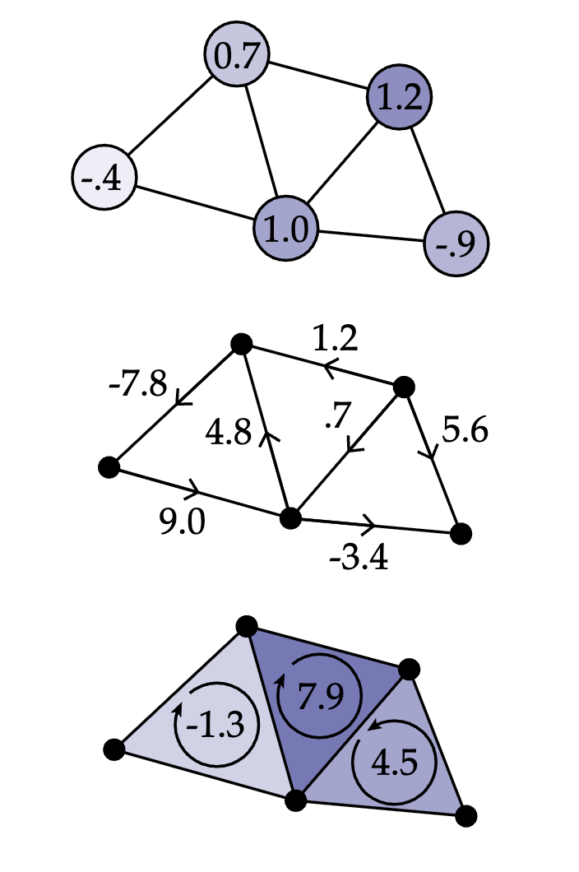
De Rham Complex Discrete Diff. Geometry
Figure Credit: Keenan Crane Discrete Differential Geometry
The de Rham complex is a model of spaces and quantities over spaces
Chains are domains you can integrate over
Forms (cochains) are quantities you can integrate
Differential operators change the dimension of a form
Dual Complex and Dual forms are analogous to “offset grids” in FD or FEM
Sharping and flatting operators approximate forms by discrete vector fields

Slide 4
Functoriality of De Rham Complex
Continuous maps between spaces induce pushforwards and pullbacks of forms
Discretized: Geometric Morphisms of Simplicial Sets induce prolongation and relaxation linear maps
Multigrid!
Notes:
The class of geometric morphisms of simplicial sets we use are the piecewise linear maps that send each simplex in the domain to the interior of some simplex in the codomain. This is a fruitful compromise between fully combinatorial maps, which can’t represent the inclusion of a subdivided grid, and arbitrary piecewise linear maps, which we have no nice data structure for. Any such map of simplicial complexes induces pullback maps on the de Rham complexes, which are where differential forms live; this induction is what in category theory we call a “functor”, which means it behaves nicely when we compose several maps together in sequence, as we’ll constantly be doing in MG.

Slide 5
Geometric Multigrid Using Generic Subdivision
Notes:
Binary, Cubic Subdivision schemes
Illustration of Geometric Morphism points embedded into interiors of simplices
Convergence plots showing that both work (at same resolution, same convergence)
Here are some of the mesh subdivision techniques we’ve played around with the most, to illustrate some examples of geometric maps. In our big examples with the results above, we wouldn’t of course be subdividing a big huge triangle, but starting with a bigger mesh that’s more rectangular.

Slide 6
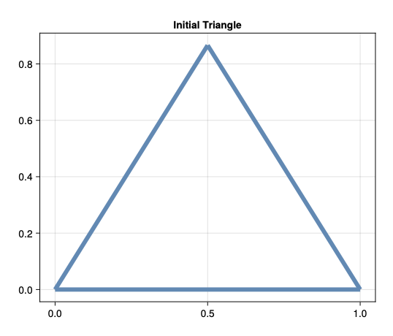
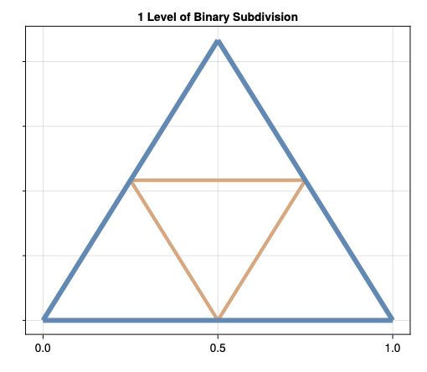
Functorial interpolation example
Geometric Morphism
Matrix Encoding of Barycentric Coordinates

Slide 7
Functorial interpolation example
Matrix Encoding of Barycentric Coordinates
Matrix Encoding of induced map on de Rham complex
[7,2]
[7,2]
[5,3]
[2.5,4.5]
A discretized vector field
[3,4]
[3,4]
[-2,7]
[0.5,5.5]
[-2,7]
Notes:
Now let’s zoom in. So, here’s the matrix expressing the geometric map of the simplest subdivision in barycentric coordinates. In multigrid we need to be able to do things like interpolate discretized vector fields along such a subdivision. Well, the beauty of our particular discretization of the functor I mentioned just now is…[click] the interpolation matrix is just the same matrix that represented the geometric map! So the data structures are really nice here and we get immediate interpolation matrices corresponding to any geometric map, which gets you multigrid an awful lot of grids very cheaply. I should mention that there are a couple of schools of thought on the restriction maps going in the other direction, and modeling the pushforward maps on the de Rham complexes; ours are just normalized transposes of these maps, so again there’s essentially no computation to do, at least if your grids are pretty geometrically homogeneous.

Slide 8
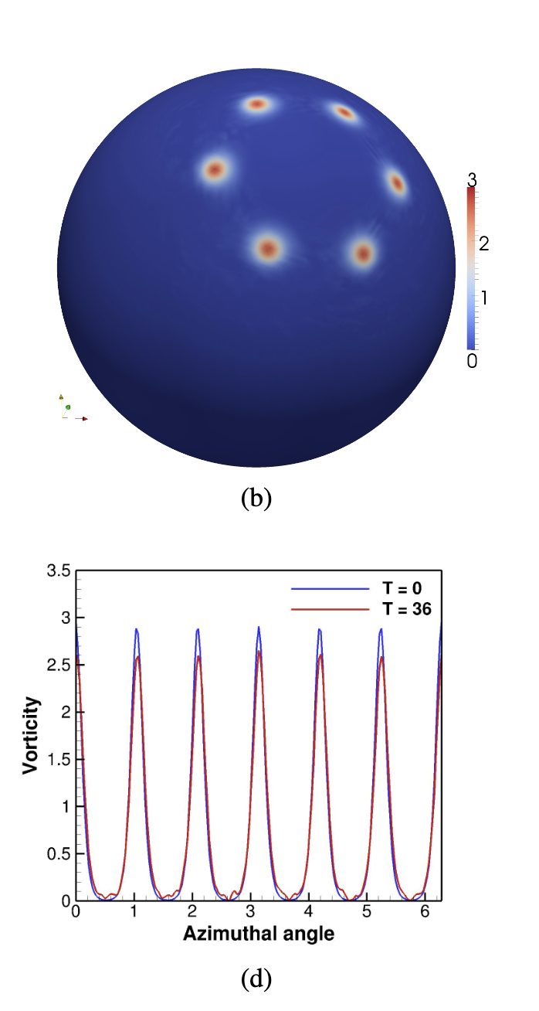
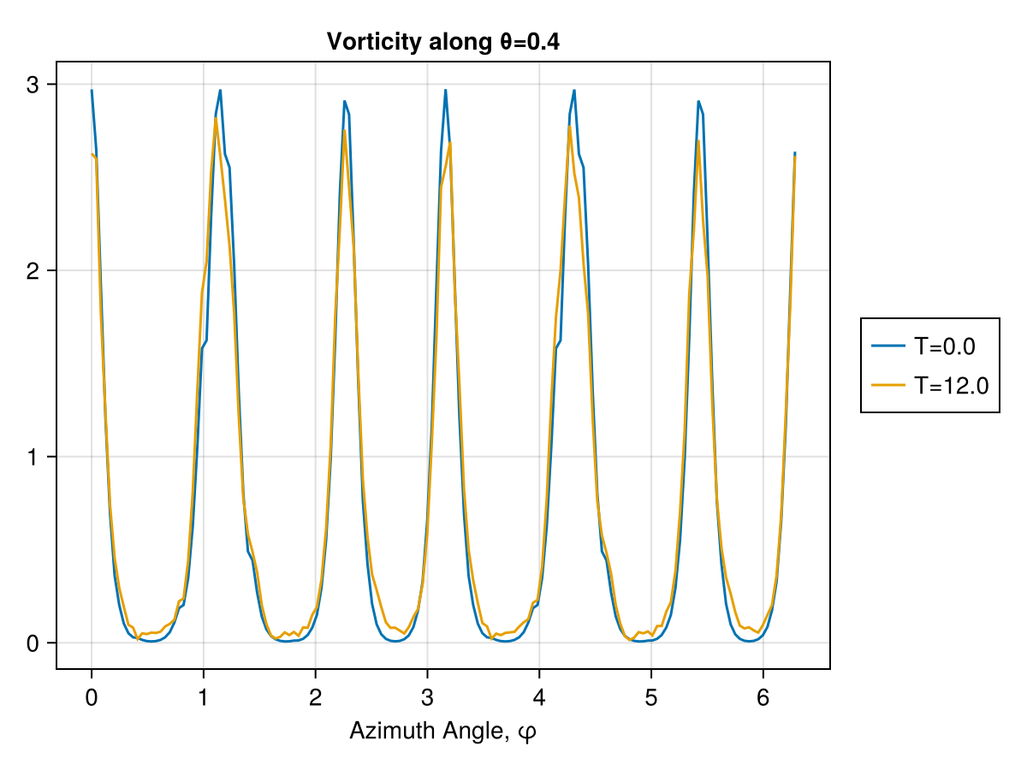
Vorticity Formulation of Incomp. Navier Stokes
eq11_inviscid_poisson = @decapode begin
d𝐮::DualForm2
𝐮::DualForm1
ψ::Form0
ψ == Δ⁻¹(⋆(d𝐮))
𝐮 == ⋆(d(ψ))
∂ₜ(d𝐮) == -1∘(♭♯, ⋆₁, d̃₁)(∧ᵈᵖ₁₀(𝐮, ⋆(d𝐮)))
end
Stable solves with nearly periodic solutions
Replicates the analysis from: Mohamed, Hirani & Samtaney 2016

Slide 9
Vorticity Formulation of Incomp. Navier Stokes
Decapodes doesn’t know any physics or fancy CFD tricks
Just Vanilla DEC + General Purpose Compute Graphs
Representation is flexible enough to capture equational rewrites
Naïve Formulation
UNSTABLE
Pressure Projection Formulation
STABLE
eq11_incorrect = @decapode begin
d𝐮::DualForm2
𝐮::DualForm1
𝐮 == d₁⁻¹(d𝐮) ∂ₜ(d𝐮) == -1 ∘(♭♯, ⋆₁, d̃₁)(∧ᵈᵖ₁₀(𝐮, ⋆(d𝐮)))
end
eq11_inviscid_poisson = @decapode begin
d𝐮::DualForm2
𝐮::DualForm1
ψ::Form0
ψ == Δ⁻¹(⋆(d𝐮))
𝐮 == ⋆(d(ψ))
∂ₜ(d𝐮) == -1∘(♭♯, ⋆₁, d̃₁)(∧ᵈᵖ₁₀(𝐮, ⋆(d𝐮)))
end

Slide 10
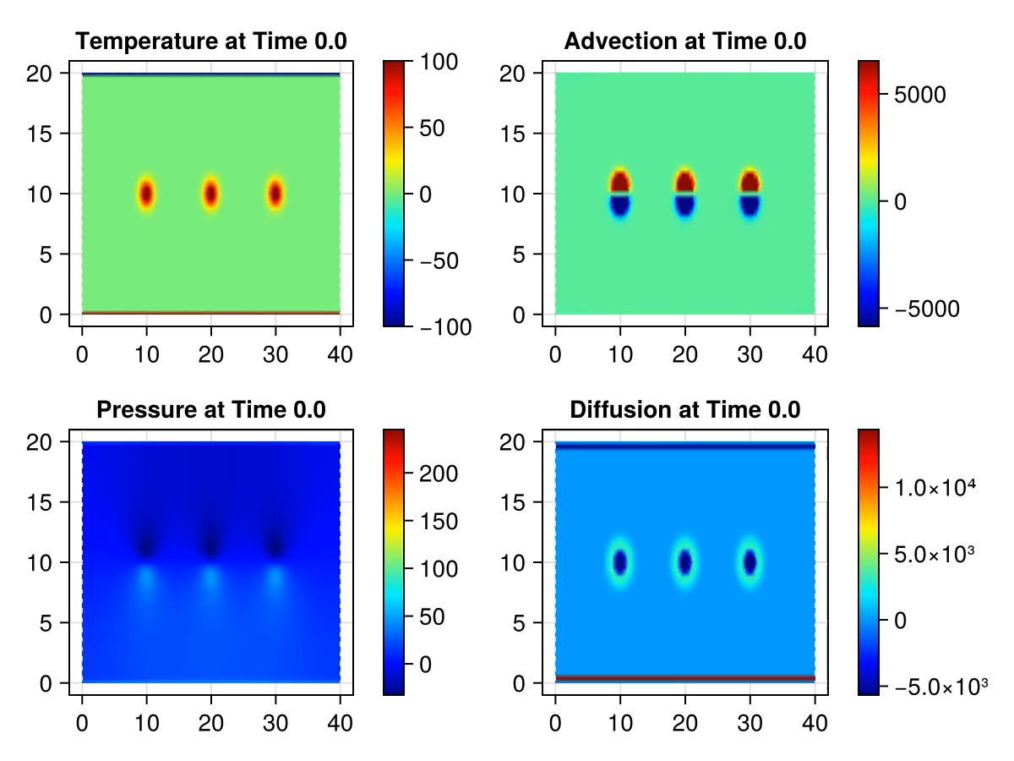
Porous Convection: Darcy + Boussinesq
Porous_Convection = @decapode begin
(λ_ρ₀Cp, αρ₀, k_ηf, ϕ)::Constant
(P, T, Adv, bound_T, bound_Ṫ)::Form0
(g, qD)::Form1
bound_T == adiabatic(T)
# Darcy flux
ρ == g ∧ (αρ₀ * bound_T)
P == Δ⁻¹(δ(ρ))
qD == -(k_ηf * (d(P) - ρ))
Adv == ⋆(interpolate(∧ᵈᵖ₁₁(⋆(d(bound_T)), qD)))
Ṫ == -1/ϕ * Adv + λ_ρ₀Cp * Δ(bound_T)
bound_Ṫ == tb_bc(Ṫ)
∂ₜ(T) == bound_Ṫ
end
Entire Specification of physics above
Divergence-free condition on pressure field enforced by pressure projection method
Notes:
Simulation and constants taken from https://pde-on-gpu.vaw.ethz.ch/lecture4/#exercise_1_thermal_porous_convection_in_2d

Slide 11
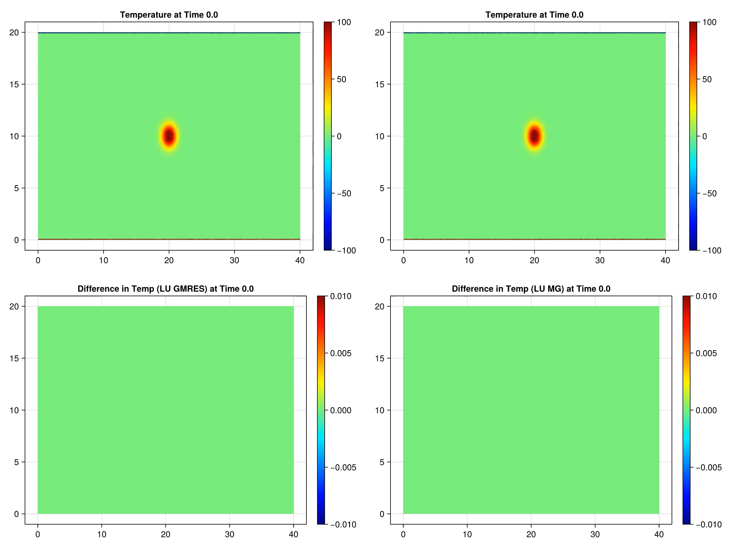
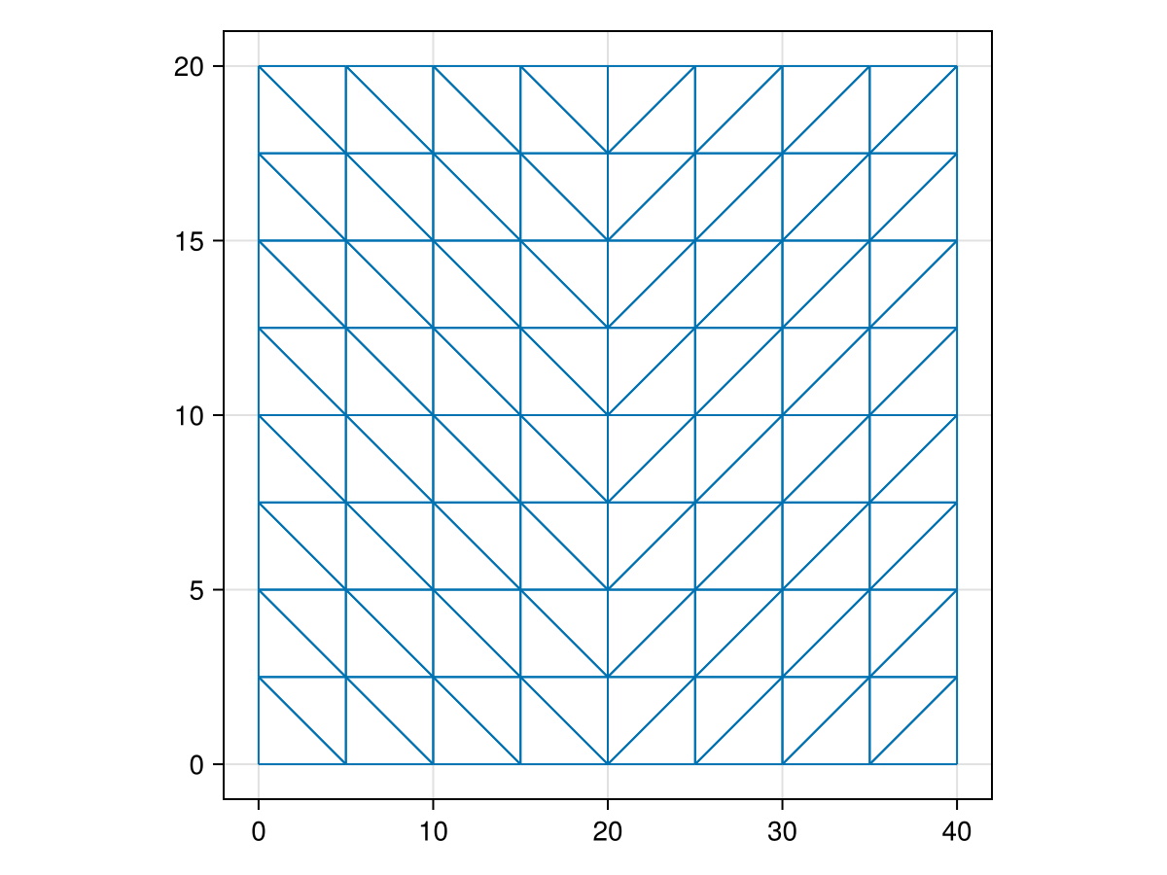
Porous convection solutions
GMRES+ILU0
GMRES+MG
Technique
Iterations to convergence
GMRES+ILU0
10 +/- 1
GMRES+MG
5 +/- 1
MG+GS
13 +/- 2
Coarsest Mesh
Notes:
Let me jump into some results. In this lovely quadriptych designed by my colleague George Rauta you see a solution of the porous convection problem as computed via the standard Krylov method GMRES, preconditioned either by ILU0 or by our multigrid implementation. In the lower row you see some computations of the error of GMRES and of our multigrid, this time just using Gauss-Seidel and no Krylov methods at all, so the simplest smoother straight from the book, and actually I think our multigrid is just a tad cleaner. On the right we have some performance stats in terms of iterations to converge. GMRES with multigrid does really rather a lot better than with ILU0 preconditioning, and even straight multigrid really is not so slow. So, our multigrid solver can drop into quite complicated systems of PDEs and do good work. Now, we haven’t put nearly as much time into optimizing this code as our friends at Krylov.jl have, but I can still show you some results with actual runtime…

Slide 12
Runtime Comparison
Levels | Direct Factorization (LU) |  | CG with ILU0 |  | Multigrid |  | CG w/ Multigrid
7 | 0.858 s | 5.369e-16 | 8.27 s | 1.484e-9 | 2.76 s | 4.130e-9 | 4.44 s | 6.193e-10
6 | ~ | ~ | ~ | ~ | 3.05 s | 7.508e-8 | 8.60 s | 1.020e-10
5 | ~ | ~ | ~ | ~ | 2.48 s | 1.862e-7 | 11.9 s | 5.564e-10
4 | ~ | ~ | ~ | ~ | 2.38 s | 2.153e-7 | 22.3 s | 1.104e-9
NV = 2,362,369, Sparsity: ~7 nnz/row
Direct Factorization: LU took 39.854 seconds and 6.72 GiB
CG with ILU0: factorization took 47.260 seconds and 17.60 GiB
Multigrid: (5 w-cycles, 3 steps of (pre/post)smoothing)
CG Multigrid: (2 w-cycles, 3 steps of (pre/post)smoothing)
Notes:
LU factors together are a magnitude denser than the original matrix, sparsity is ~186.7)
ILU From KrylovPreconditioners.jl,
These results were worked out for a simple Laplacian solve on a big old mesh with 2 million vertices, so, just LU factorizing and solving is really fast once you have the factorization, but if you look below you see computing the factorization in the first place is way too slow. Even just heuristically computing the ILU0 preconditioner for the conjugate gradient method was kind of crazy. With raw multigrid and Gauss-Seidel we see we’re extremely fast in comparison, and with seven meshes the error is not too bad; or we can squeeze another OOM out of the error by using MG to precondition CG instead. So, what does out implementation look like?

Slide 13
Convergence Results
Decapodes supports arbitrary geometric maps for the levels of the multigrid
Binary and Cubic subdivision schemes behave well on our test problems
Notes:
s = triangulated_grid(1,1,1/4,sqrt(3)/2*1/4,Point3D,false)
function plot_residuals(s; cycles=1:50, timeit=false)
i = 0
function residuals(scheme::AbstractSubdivisionScheme, level, sizes)
series = PrimalGeometricMapSeries(s, scheme, level);
md = MGData(series, sd -> ∇²(0, sd), 3, scheme)
sd = finest_mesh(series)
push!(sizes, nv(sd))
L = first(md.operators)
b = L*rand(nv(sd)) #put into range of the Laplacian for solvability
u0 = zeros(nv(sd))
ress = map(cycles) do cyc
if timeit
# 2[schemes] * 3[levels'] * 50[cycles'] = 300[trials]
@info i
i += 1
@elapsed u = multigrid_vcycles(u0,b,md,cyc)
else
u = multigrid_vcycles(u0,b,md,cyc)
norm(L*u-b)/norm(b)
end
end
end
bin_sizes = []
bin_ress = map(lev -> residuals(BinarySubdivision(), lev, bin_sizes), 2:4)
cub_sizes = []
cub_ress = map(lev -> residuals(CubicSubdivision(), lev, cub_sizes), 2:4)
f = Figure()
ax = CairoMakie.Axis(f[1,1];
title = "Multigrid V-cycles",
yscale = timeit ? identity : log10,
ylabel = timeit ? "execution time [s]" : "log₁₀(relative error)",
xlabel = "# cycles")
colors = [:blue, :green, :orange]
for lev in 1:3
lines!(ax, bin_ress[lev],
label="binary, $(lev+1) levels, $(bin_sizes[lev]) vertices",
linestyle=:solid, color=colors[lev])
lines!(ax, cub_ress[lev],
label="cubic, $(lev+1) levels, $(cub_sizes[lev]) vertices",
linestyle=:dash, color=colors[lev])
end
f[1,2] = Legend(f,ax,"Scheme")
f
end
plot_residuals(s, timeit=true)

Slide 14
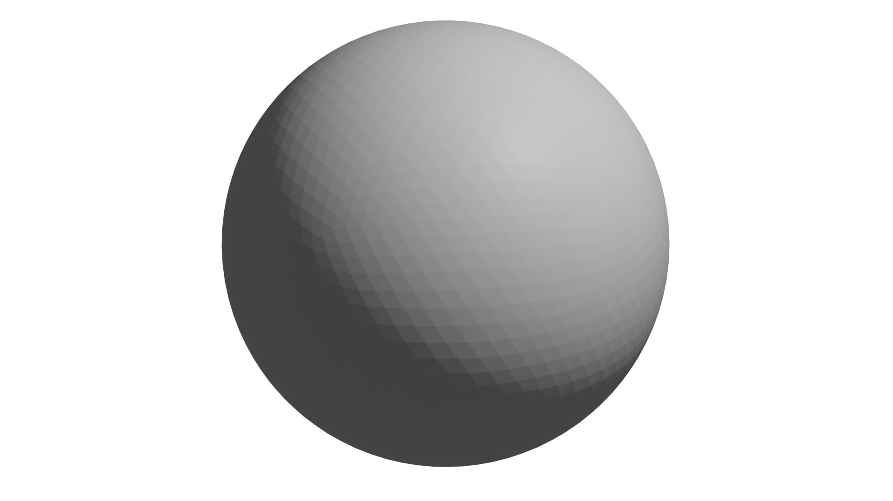
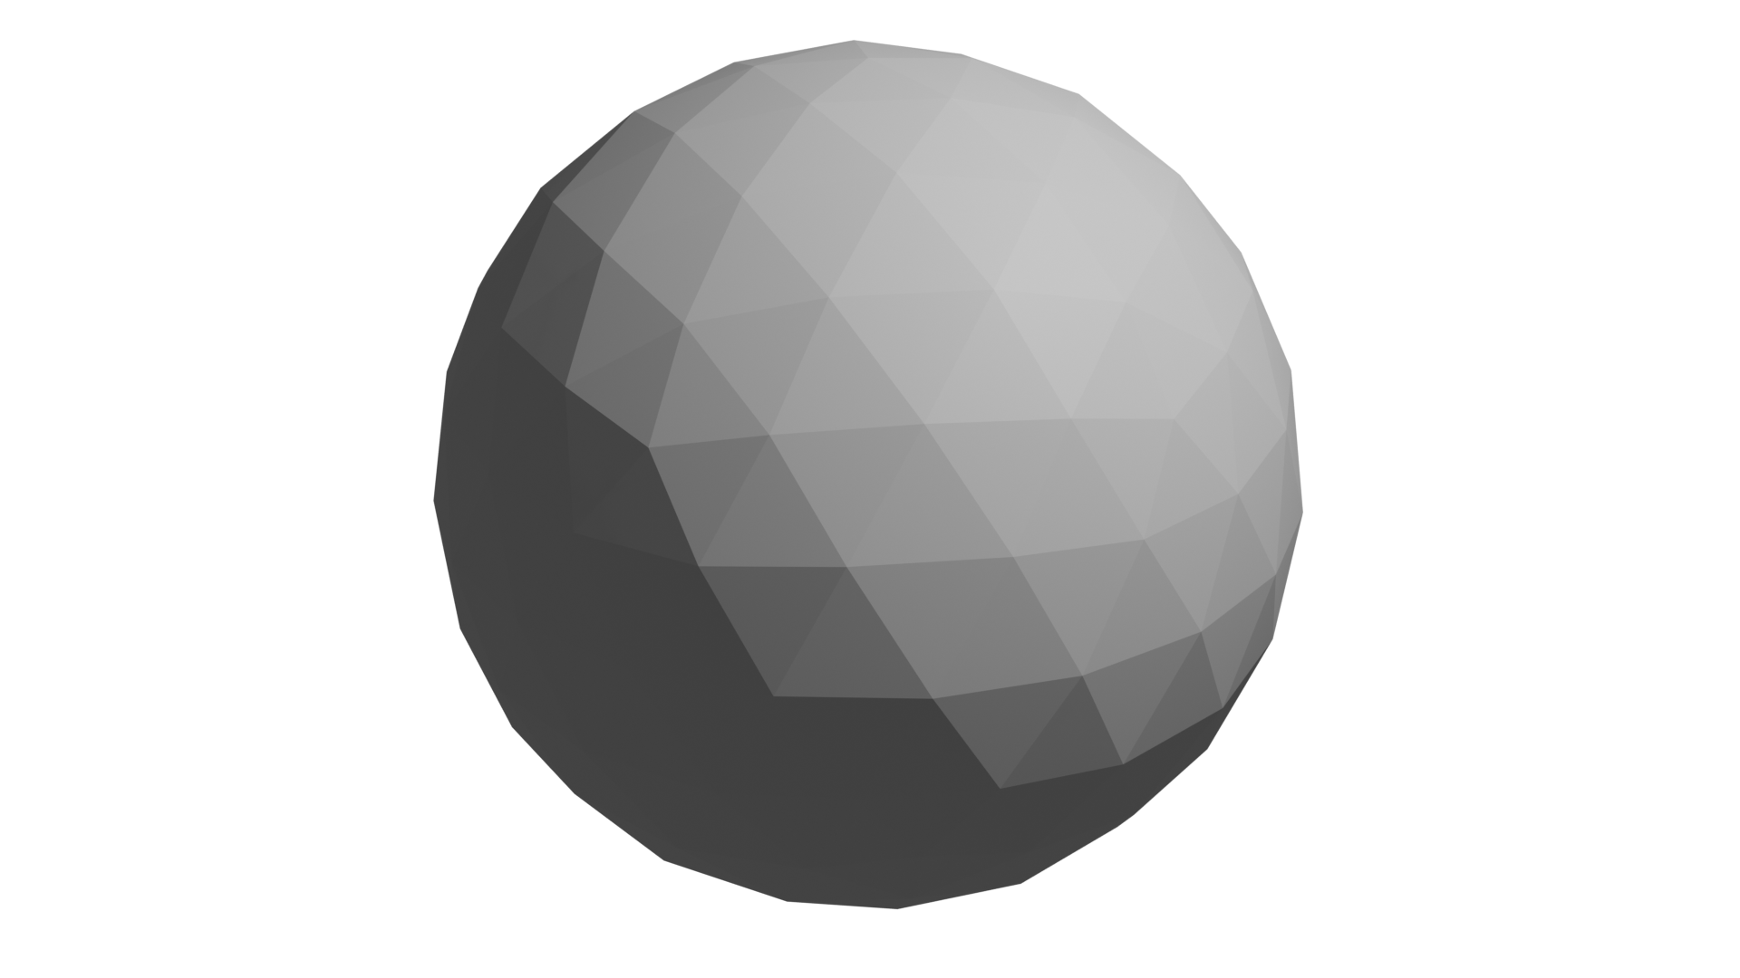
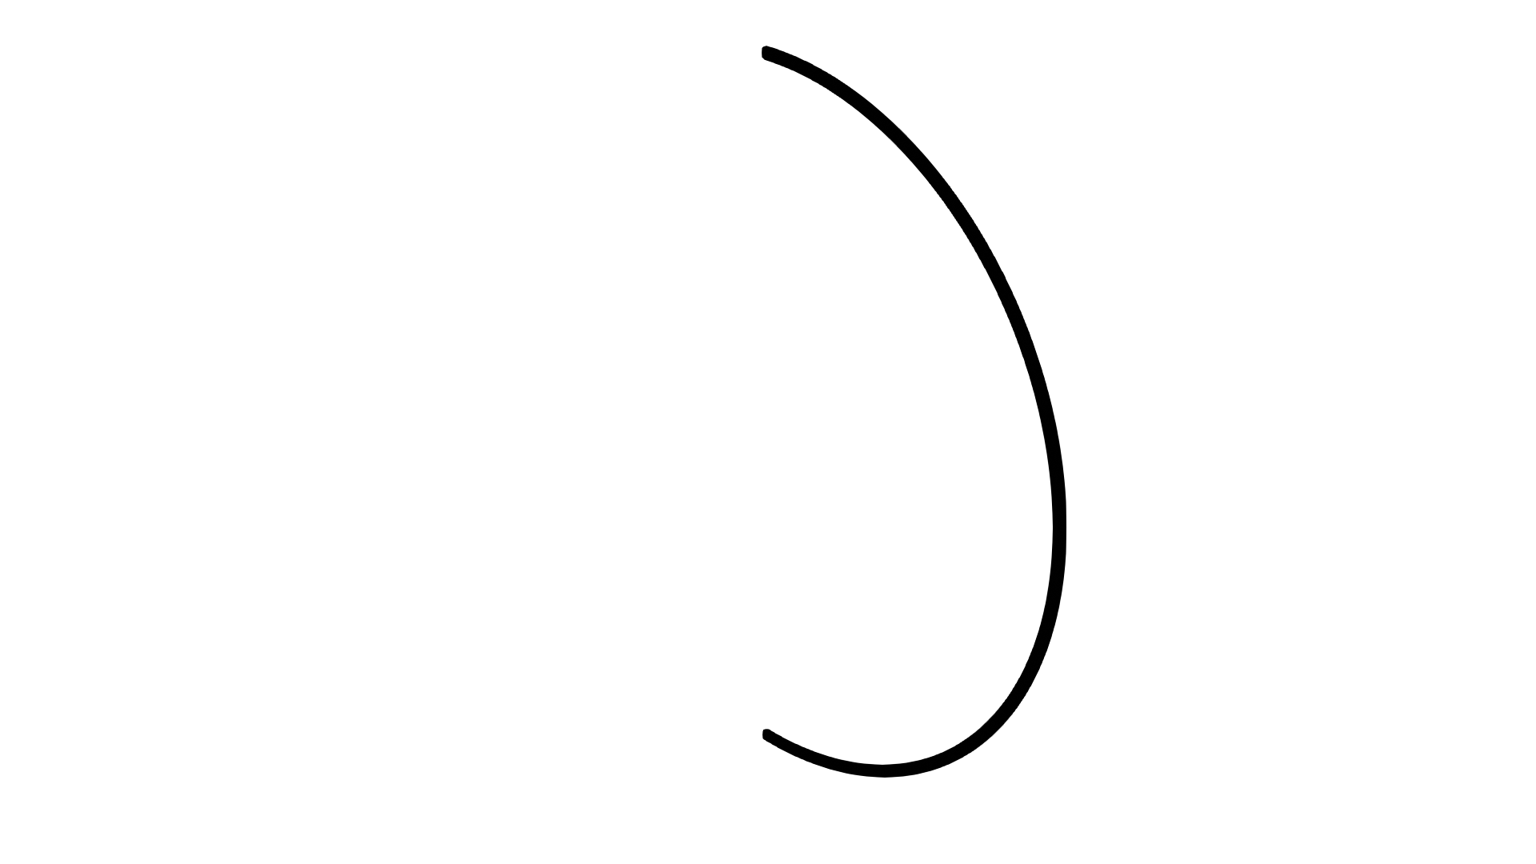
M3P: Multidomain, Multiscale, Multiphysics
Multiphysics: composing physical laws
Multiscale: need multiple grid with different resolutions
Multidomain: complex scenarios need different physics on different domains
Interface

Slide 15
Conclusions
Geometric Multigrid for de Rham complexes of arbitrary simplicial meshes is straightforward
Decapodes is an advanced simulation platform for DEC and a strong platform for disseminating solver improvements to applications in diverse areas of physics
Future Directions: Distributed Memory Parallelism, FEEC, Specialized numerics for CFD/EM

Slide 16
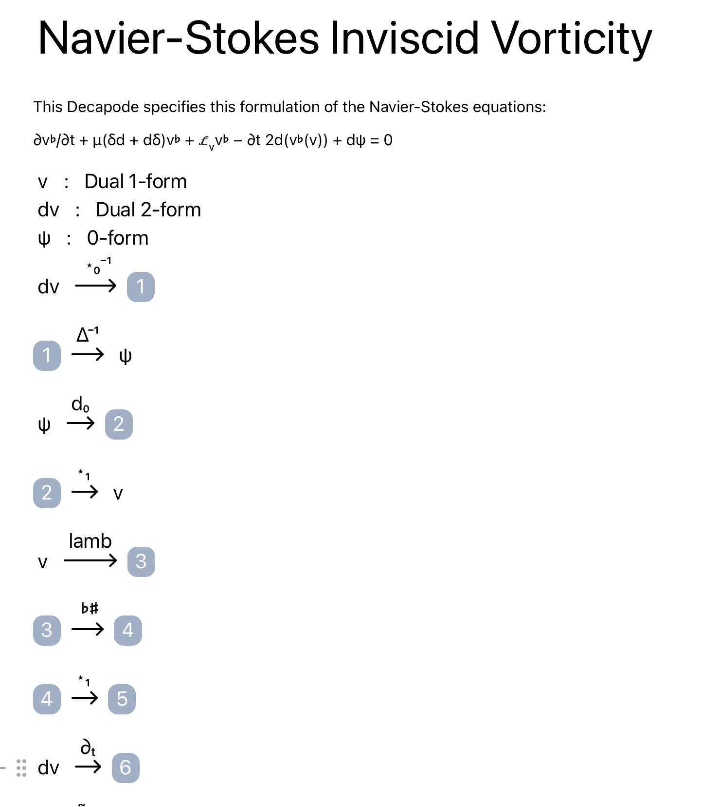
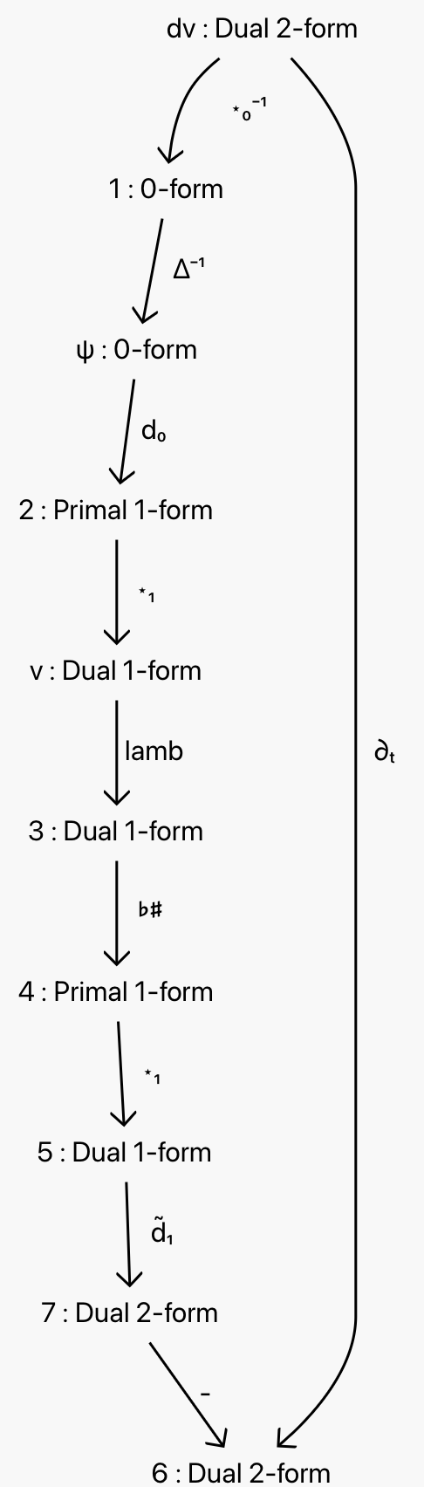
CatColab DSL and visualizer
Notes:
Simulation and constants taken from https://pde-on-gpu.vaw.ethz.ch/lecture4/#exercise_1_thermal_porous_convection_in_2d

Slide 17
M3P: Multidomain, Multiscale, Multiphysics
Multiphysics: composing physical laws
Multiscale: need multiple grid with different resolutions
Multidomain: complex scenarios need different physics on different domains
Interface

Slide 18
Vector Calculus Diagrams
Diffusion: Laplacian Formulation
Scalar and vector fields are the objects
Differential operators Div, Grad, Curl are arrows
Allow functions (f/k) on scalar/vector fields too
Diffusion: Fick’s Law Formulation
Notes:
Semi-Simplicial Sets capture the combinatorial aspects of a geometric object
CombinatorialSpaces.jl supports coordinates and orientations, which are necessary for DEC
Uses a generic implementation predating our adoption of Simplicial Meshes

Slide 19
Building Multiphysics with Wiring Diagrams
Junctions are Variable : Domain
Boxes are subsystem (component physics)
Ports are exposed variables in the subsystems
Wires connect ports to junctions with matching domains
Outer Ports allow hierarchy by exposing variables of the composite system to next level of hierarchy
Notes:
Semi-Simplicial Sets capture the combinatorial aspects of a geometric object
CombinatorialSpaces.jl supports coordinates and orientations, which are necessary for DEC
Uses a generic implementation predating our adoption of Simplicial Meshes

Slide 20
Physical Principles in Vector Calculus
Fick’s Law of Diffusion
Scalar Transport by Advection
Conservation of Mass
Superposition of Flux
Notes:
Semi-Simplicial Sets capture the combinatorial aspects of a geometric object
CombinatorialSpaces.jl supports coordinates and orientations, which are necessary for DEC
Uses a generic implementation predating our adoption of Simplicial Meshes

Slide 21
Advection Diffusion Multiphysics Model
Notes:
Semi-Simplicial Sets capture the combinatorial aspects of a geometric object
CombinatorialSpaces.jl supports coordinates and orientations, which are necessary for DEC
Uses a generic implementation predating our adoption of Simplicial Meshes

